Slide 1
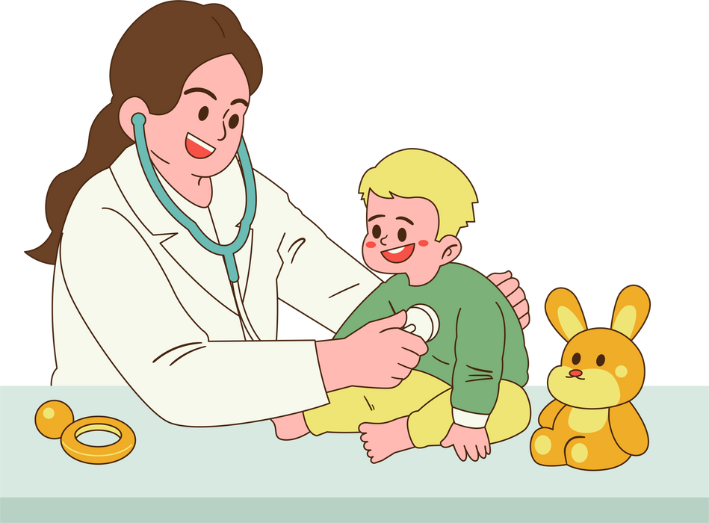
When children are ill, parents want them to feel better as soon as possible. But sometimes a medical treatment does more harm than good. That is why the EAP Choosing Wisely Group has created this short booklet.
RECOMMENDATIONS FOR
Parents
https://www.eapaediatrics.eu/advisory- groups/choose-wisely/

Slide 2
EAP CW Top 10 Recommendations:
#Cough Medication: Do not recommend, prescribe or use cough medicines in children.
#Bronchiolitis: Do not routinely use steroids and bronchodilators in infants presenting with bronchiolitis.
#IV-Antibiotic Duration: Do not routinely prolong IV antibiotics to treat severe infections, but consider switching to the oral form as soon as the clinical condition has improved.
#Acute Otitis Media & Antibiotics: Do not routinely use antibiotics in children with acute otitis
media when self-resolution is expected.
#Antibiotics in Neonates: Do not prescribe antibiotics for neonates without clinical signs of sepsis.
#Hospitalization of Febrile Infants: Do not routinely continue hospitalization in well-appearing
febrile infants once bacterial cultures have been confirmed negative for 24 to 36 hours if adequate outpatient follow-up can be assured.
#Duration of Neonatal Antibiotics: Do not continue antibiotic therapy for suspected neonatal
sepsis >36-48 hours without clear suspicion of bacterial infection.
#IgE Testing: Do not perform screening panels (IgE tests) for food allergies without a history
consistent with a specific food allergy.
#Urine Culture: Do not request urine culture in febrile children older than 2 months with respiratory tract infection.
#Gastroesophageal Reflux: Do not routinely prescribe acid blockers
and motility agents in infants with GER.

Slide 3
1
Do not recommend, prescribe or use cough medicines in children
#Cough Medication

Slide 4
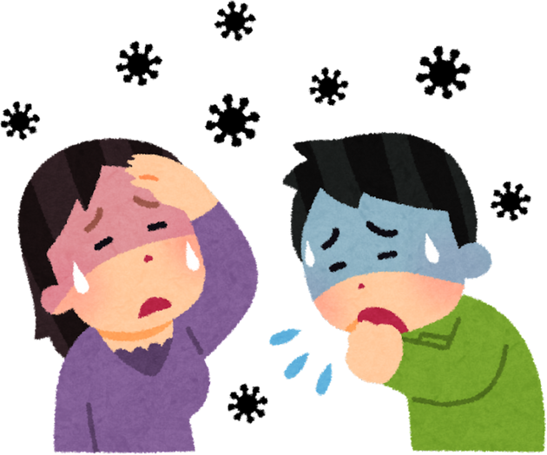
WHAT SHOULD A PARENT DO WHEN THE CHILD HAS A COUGH?
GOOD TO KNOW: Coughing is generally a normal defense mechanism of the body and is mostly related to acute respiratory infections in children.
What is known about cough medicine:
Herbal and chemical cough medicines are not effective against colds.
Many products have more than one active ingredient. Taken together with other medicines, they can lead to overdoses of these active substances.
What can you do to help your child:
TO DO:
Provide a good indoor environment with a humidity of 50-60% and a room temperature of 18°C.
Elevate the child’s upper body.
Nasal irrigation with normal saline in case of cough due to drip into the airways from the back of the nose.
Give honey to children aged 12 months and older: with a teaspoon or in a warm drink.
NOT TO DO:
Do not expose the child to cigarette smoke.
Herbal and chemical cough medicines are not effective against colds.
Many products have more than one active ingredient. Taken together with other medicines, they can lead to overdoses of these active substances.
#Cough Medication

Slide 5
2
Do not routinely use steroids and bronchodilators in infants presenting with bronchiolitis
#Bronchiolitis

Slide 6
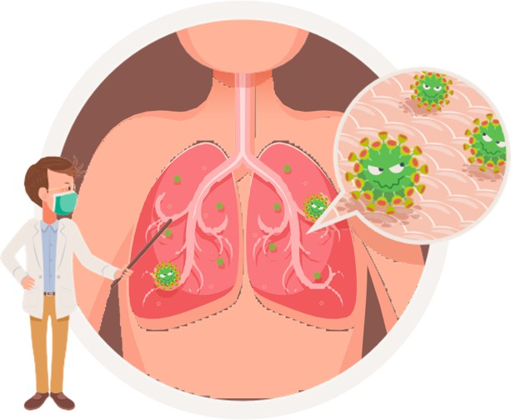
WHAT SHOULD A PARENT DO WHEN AN INFANT HAS A BRONCHIOLITIS? ARE MEDICINES REALLY NEEDED?
GOOD TO KNOW: Bronchiolitis is a common and usually self-limiting respiratory infection in children.
What is known about steroids and bronchodilators in case of bronchiolitis:
Studies show that commonly prescribed medicines such as bronchodilators and glucocorticoids do not help the infant with bronchiolitis. Their use can, however, be associated with an accelerated heart rate, a drop in blood oxygen levels, and agitation.
Most children with bronchiolitis recover in 1-2 weeks without any specific treatment.
What can you do to help your child:
TO DO:
NOT TO DO:
BUT:
Contact your doctor if your child shows difficulties in breathing, problems with feeding or drinking, pale skin, blue lips, or changes in behavior (drowsiness, irritability, lack of interest, etc.).
Cleanse the nose with a saline solution.
Allow your child to drink small portions frequently.
Continue breastfeeding.
Give your child time to recover.
Do not expose the child to cigarette smoke.
#Bronchiolitis
#Gastroesophageal reflux

Slide 7
3
Do not routinely prolong IV antibiotics to treat severe infections, but consider switching to the oral form as soon as the clinical condition has improved
#IV-Antibiotic Duration

Slide 8
WHAT SHOULD A PARENT DO WHEN THE CHILD HAS A SEVERE INFECTION TREATED WITH INTRAVENOUS ANTIBIOTICS?
GOOD TO KNOW: In case your child presents a severe infection (i.e., pyelonephritis, osteomyelitis, and severe pneumonia) he/she would be hospitalized, and IV antibiotic therapy would surely be started. The physician can decide to rapidly switch the intravenous with oral route when your child’s conditions and his/her blood tests are improved.
What is known about antibiotics:
Antibiotics are medicines that kill or stop the growth of bacteria to cure infections.
In case of severe bacterial infections, antibiotics are mandatory. Your doctor will choose the appropriate antibiotic, route of administration, and length of therapy.
Antimicrobial resistance is one of the top global public health problems. The misuse and overuse of antimicrobials is the main driver in the development of bacterias that are resistant to antibiotics.
What can you do to help your child:
TO DO:
Trust your pediatrician and follow their advice.
Let your child know that they will get better soon and will be able to go home from the hospital quickly.
Ask questions if you have concerns or are not clear about what they wish that you do.
NOT TO DO:
Do not be worried about the switch.
#IV-Antibiotic Duration
#Gastroesophageal reflux

Slide 9
4
Do not routinely use antibiotics in children with acute otitis media when self-resolution is expected
#Acute Otitis Media & Antibiotics

Slide 10
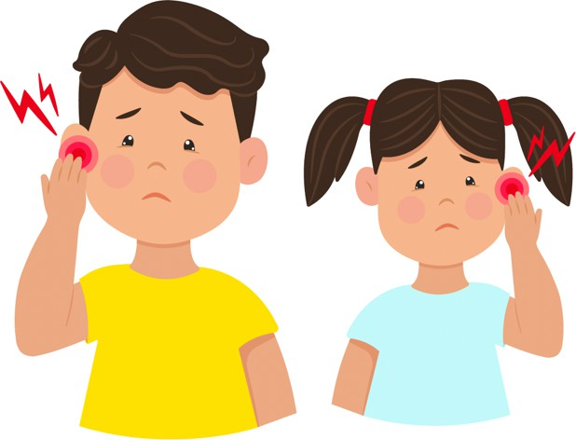
WHAT SHOULD A PARENT DO WHEN THE CHILD HAS A MIDDLE EAR INFECTION? ARE ANTIBIOTICS REALLY NEEDED?
,
GOOD TO KNOW: Most children with middle ear infection recover without antibiotics in 2-3 days. Viruses are usually the cause, and antibiotics won't help in these cases.
What is known about antibiotics:
Using antibiotics when they are not needed can cause harmful effects like diarrhea or allergic reactions and help resistant bacteria grow. Studies show that antibiotics do not reduce pain in the first 24 hours.
What can you do to help your child:
TO DO:
Give your child pain relievers (such as paracetamol or ibuprofen) to make him/her more comfortable.
Take your child to the doctor if symptoms do not improve after 48 - 72 hours.
Vaccination against pneumococcus has proven to be highly effective.
NOT TO DO:
Do not give antibiotics unless the doctor says they are needed.
BUT:
Sometimes immediate antibiotic treatment is needed:
Children 6 months and younger.
Severe pain and fever > 39 °C despite proper medication with paracetamol or ibuprofen.
Children with complicating conditions (a cleft palate, an immune disorder, Down syndrome, a cochlear implant and other).
#Acute Otitis Media & Antibiotics
#Gastroesophageal reflux

Slide 11
5
Do not prescribe
antibiotics for neonates without clinical signs of sepsis
#Antibiotics in Neonates

Slide 12
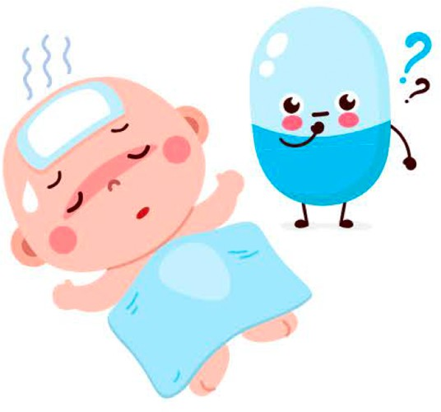
WHAT SHOULD PARENTS UNDERSTAND ABOUT ANTIBIOTICS IN NEWBORNS? ARE THEY REALLY NEEDED IN NEONATES WITHOUT CLINICAL SIGNS OF SEPSIS?
GOOD TO KNOW: Close observation of newborns born at term with risk of infection will detect symptoms in time to start antibiotics.
What is known about neonatal sepsis and antibiotics:
Bacterial infection in newborns (also called neonatal sepsis) is rare but may be a very severe condition.
Some conditions, like maternal fever or early rupture of membranes, increase the risk of infection.
Most babies with risk factors remain healthy and don't need antibiotics. Giving them unnecessary antibiotics could actually cause harm. However, if a baby does develop a bacterial infection, they will show warning signs such as fast or labored breathing, fast heart rate, gray-marbly skin, unusual low or high temperature, and feeding problems.
Close observation for these signs, repeated assessment and - if necessary - blood tests is recommended.
Early antibiotic treatment comes with several drawbacks, including disruption of the bonding time between mother and baby, insertion of an IV line, and longer hospital stays. More importantly, antibiotics interfere with the development of healthy gut bacteria in newborns that might prevent diseases later in life, including obesity, inflammatory bowel disease, asthma, and allergy.
What can you do to help your child: TO DO:
Trust your physician and their decision.
Reassure your family that the course will be good, and the length of hospital stay as short as possible.
If you would like to have more information on the decision don’t hesitate to ask your doctor; pros and cons need to be balanced when deciding the use of antibiotics.
#Antibiotics in Neonates
#Gastroesophageal reflux

Slide 13
6
Do not routinely continue hospitalization in well-appearing
febrile infants once bacterial cultures have been confirmed negative for 24 to 36 hours if adequate outpatient follow-up
can be assured
#Hospitalization of Febrile Infants

Slide 14
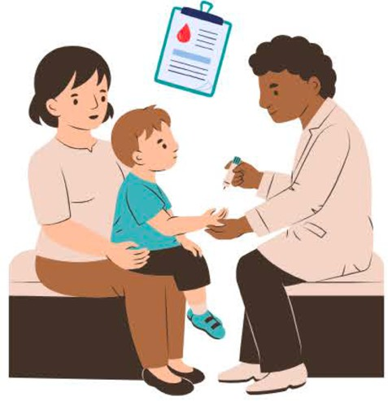
HOW SHOULD A PARENT DEAL WITH THE CHILD’S HOSPITALIZATION? IS IT ALWAYS THE BEST OPTION?
GOOD TO KNOW: Fever in children is common and usually means their body is fighting an infection. With proper care, most fevers can be safely treated at home. When a child has a fever, doctors often do tests to check for serious infections. If your child seems well and the bacterial tests (blood cultures) are negative after 24-36 hours, staying in the hospital
usually isn’t needed. Being at home is often safer and more comfortable for both you and your child.
What is known about staying in the hospital:
Most serious infections show up quickly, usually within the first 24 hours. If tests are clear, keeping your child in the hospital longer doesn’t make them safer, and they’re more likely to be exposed to other germs.
What can you do to help your child:
TO DO:
NOT TO DO:
If your child shows improvement and bacterial cultures are negative after 24-48 hours, trust your doctor’s recommendation that being discharged from the hospital and receiving follow-up while staying home is safe.
Stay in contact with your family doctor or visit the emergency room, if necessary, especially if there are any concerning changes in your baby’s health.
Ensure your child recovers in a familiar and comforting environment at home.
Don’t hesitate to ask questions if you have any concerns.
Do not extend hospital stays unnecessarily, as this increases your child's risk of hospital- acquired infections.
Don’t worry about early discharge – the tests together with observations are thorough and reliable.
Avoid giving unnecessary medications if the doctor advises they aren't needed.
#Hospitalization of Febrile Infants
#Gastroesophageal reflux

Slide 15
7
Do not continue antibiotic therapy for suspected neonatal sepsis
>36-48 hours without clear suspicion of bacterial infection
#Duration of Neonatal Antibiotics

Slide 16
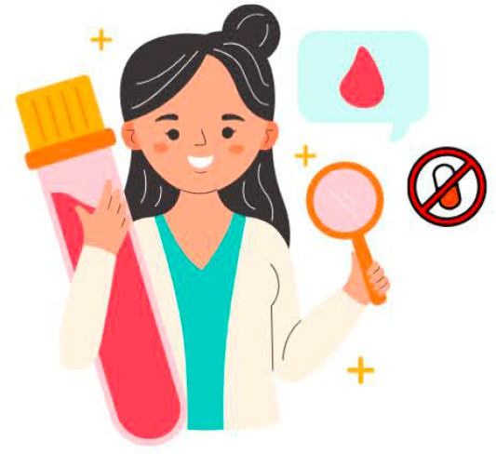
WHAT SHOULD PARENTS UNDERSTAND ABOUT ANTIBIOTICS IN CASE OF SUSPECTED NEONATAL SEPSIS? IS A SHORT COURSE ENOUGH?
GOOD TO KNOW: To avoid severe bacterial infection doctors might prescribe antibiotics for newborn babies more often than they should, but the course of antibiotics can usually be stopped after a couple of days if infection is not suspected anymore.
What is known about neonatal sepsis and antibiotics:
Bacterial infection in newborns (also called neonatal sepsis) is rare but may be a very severe condition.
The symptoms of an infection in newborns may be unclear and infection difficult to rule out by symptoms only.
Repeated physical examinations together with blood samples are often helpful but may take a couple of days before a possible infection is ruled out.
It is safe to stop antibiotics after 36-48 hours if close observation of symptoms and signs and blood results make an infection unlikely.
Like all medicines, antibiotics can cause unwanted side effects, so they should be given for the shortest time needed.
What can you do to help your child:
TO DO:
Be confident with the medical team about their decision.
Let your family know that a shorter antibiotic course is safe and the benefits of not treating outweighs the risks after 36-48 hours.
Don’t hesitate to ask questions if you have any concerns.
NOT TO DO:
Do not be worried about the short treatment.
#Duration of Neonatal Antibiotics
#Gastroesophageal reflux

Slide 17
Do not perform screening panels (IgE
8
tests) for food allergies without a history consistent with a specific food
allergy
#IgE Testing

Slide 18
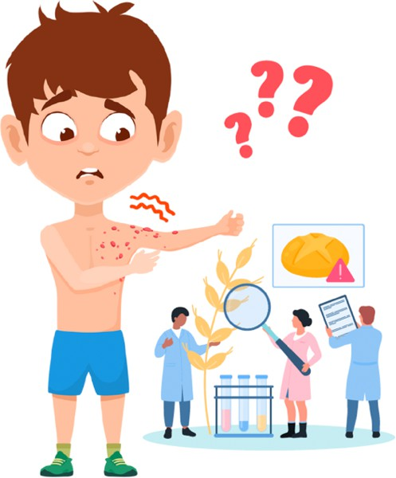
WHAT SHOULD PARENTS UNDERSTAND ABOUT IGE TESTING?
DON’T BE TOO KEEN TO SCREEN!
GOOD TO KNOW: IgE levels in a blood test can be high without the body being actually allergic to anything. This can happen especially in kids with eczema.
What is known about IgE blood tests:
Blood tests to check for food allergies only give clear results if there's a known history of an allergic reaction to a specific food.
Common signs of a food allergy include symptoms like skin rashes, vomiting, diarrhea, swelling, or, in some cases, breathing problems. These reactions usually happen within minutes to a few hours after eating the food.
When using blood tests, it’s best to only test for specific foods suspected of causing allergies, rather than testing broadly.
It’s important to remember that IgE tests are not a form of treatment—they are just part of diagnosing allergies and can sometimes lead to unnecessary restrictions or worry if used too broadly.
What can you do to help your child:
TO DO:
Discuss any symptoms of your child with the doctor before making any big changes to their diet.
A diverse diet with high variety in foods including allergens can protect a child from developing food allergies. Remember: colorful food - for a good mood!
NOT TO DO:
Do not restrict or eliminate certain foods without a reason. Doing so can cause unnecessary stress for both you and your child, and it might even lead to nutritional deficiencies.
#IgE Testing
#Gastroesophageal reflux

Slide 19
9
Do not request urine culture in febrile
children older than 2 months with respiratory tract infection
#Urine Culture

Slide 20
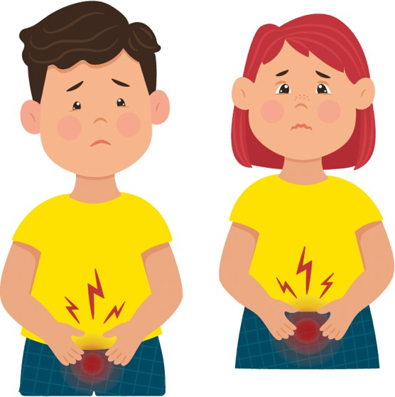
SHOULD A PARENT BE WORRIED ABOUT AN URINARY TRACT INFECTION WHEN THE CHILD HAS FEVER?
GOOD TO KNOW: Cultures aren't always reliable. If a urinary tract infection (UTI) is unlikely, the test can detect bacterias that are just a contamination. This means your child might get unnecessary antibiotics, which have side effects but no benefits.
What is known about urinary tract infections:
Urine samples can pick up bacteria during collection, often labeled as false positive samples.
Healthy children can have small amounts of bacteria in their urine. This is called asymptomatic bacteriuria, which doesn't need treatment but shows positive on tests.
After 2 months of age, if a fever has an obvious cause (like an ear infection or sore throat), a UTI is unlikely.
Beside the risk of over-treating, urine sampling by a catheter or similar may be painful and should be avoided when not needed.
What can you do to help your child:
TO DO:
Inform your doctor if your child has a higher risk of urinary tract infections such as: kidney or bladder problems, previous UTIs, treatments or health issues that weaken the immune system or other relevant medical conditions.
Make a plan with your doctor for what to do if your child's condition worsens.
BUT:
You can ask about the risks of waiting and discuss options with your doctor. They will help you weigh the pros and cons based on your child's situation.
#Urine Culture
#Gastroesophageal reflux

Slide 21
10
Do not routinely prescribe acid blockers
and motility agents in infants with GER
#Gastroesophageal reflux

Slide 22
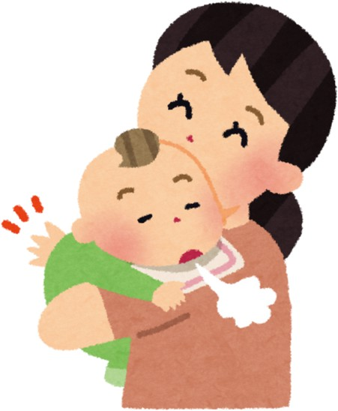
WHAT SHOULD A PARENT DO WHEN AN INFANT HAS GASTROESOPHAGEAL REFLUX (GER)?
GOOD TO KNOW: Spitting up or vomiting of milk after feeds is very common in infancy, and usually not any reason for concern.
Medications for gastroesophageal reflux work to decrease the acid in babies’ stomachs, but the medications do not affect the fussiness or spitting up. Medications may have side effects, such as chest infections and
reduced uptake of important nutrients, so it’s best to avoid taking them unless necessary.
What is known about GER:
In infants the valve between the esophagus and the stomach is immature.
The muscular valve will strengthen as babies grow and develop, the baby will be increasingly upright, and the regurgitation will subside.
What can you do to help your child:
TO DO:
If the baby is growing well, make sure to avoid overfeeding because the excess milk will come out.
Ensure that swallowed air during feeds is allowed to come out – burping.
In rare cases feed thickeners may reduce the frequency of spitting. Ask your pediatrician if your child might benefit from it.
NOT TO DO:
Do not switch to a different kind of infant formula or give up breastfeeding without discussing it with a professional.
BUT:
In a minority of babies, their reflux affects their ability to feed and grow,
or they may have other health concerns. These infants have gastroesophageal
reflux disease (GERD), and they may warrant medications prescribed by their health care providers after careful consideration and investigation.
#Gastroesophageal reflux
#Gastroesophageal reflux

